Slide 1
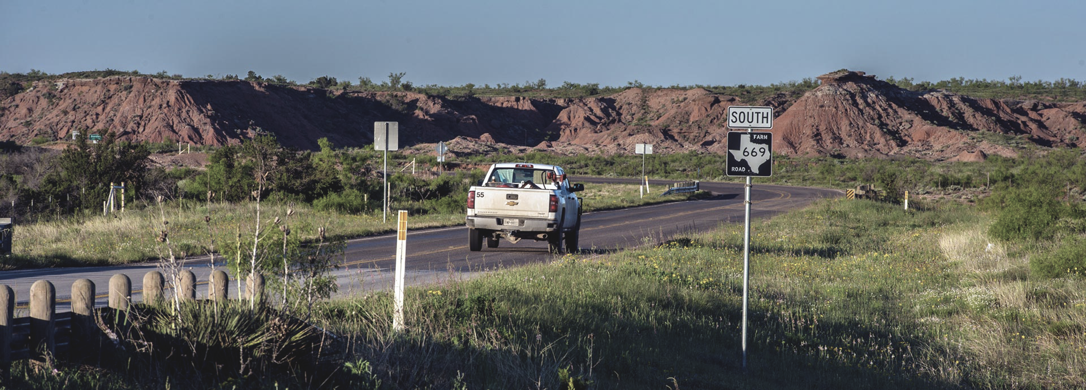

SUMMER2024
TRAFFIC SIGNS
DETECTION
by Do Tuan Kiet

Slide 2
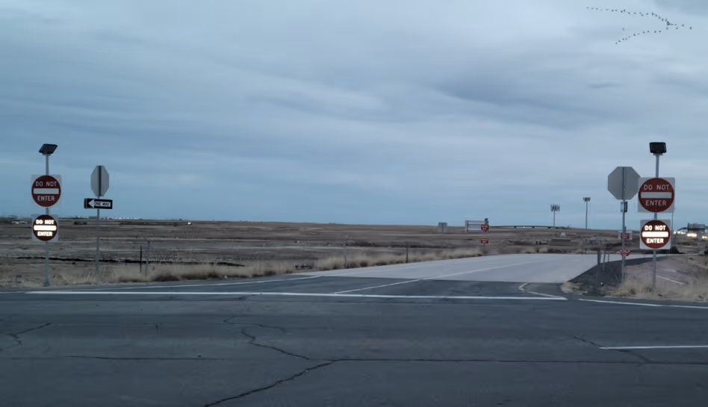

Introduction
Project topic
Data source
Methods
Definition
HOG
SVM
KNN
Demo code
Executes code
Summarizes and evaluates project results
Conclusion

Slide 3

INTRODUCTION

Slide 4
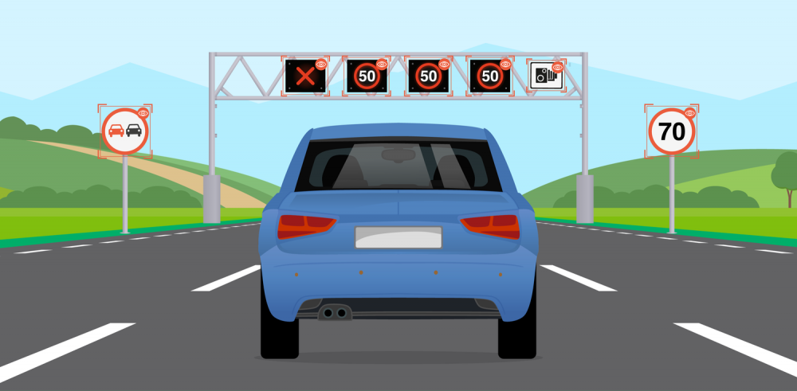
Project topic
Traffic signs recognition is crucial to advanced driver assistance systems (ADAS) and autonomous driving technologies. Accurate detection and classification of traffic signs enhance road safety by providing timely information to drivers or autonomous systems.

Slide 5
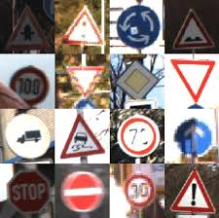
Dataset
Collect a dataset of traffic sign images from publicly available
repositories such as the German Traffic Sign Recognition Benchmark (GTSRB).

Slide 6
Methods
Extracts HOG features
Training
KNN & SVM
Detects & Recognize Image
Import Data

Slide 7
DEFINITION

Slide 8
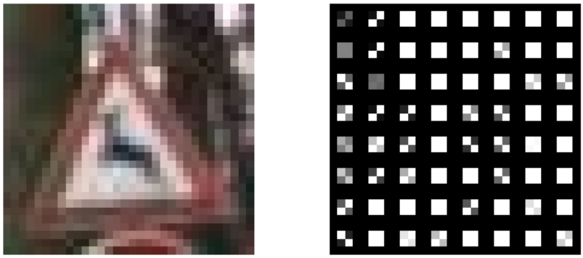
HOG
A feature descriptor used in computer vision and image processing for object detection. It counts the occurrences of gradient orientation in localized portions of an image, providing a dense representation of the image's structure.

Slide 9
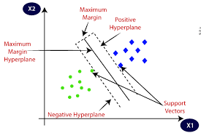
SVM
A supervised machine learning algorithm used for classification and regression tasks. It finds the hyperplane that best separates the data into different classes, maximizing the margin between the closest points of the classes.

Slide 10
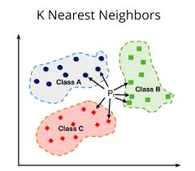
KNN
A simple, instance-based learning algorithm used for classification and regression. It classifies a data point based on how its neighbors are classified, where "K" is a user-defined constant that represents the number of nearest neighbors to consider.

Slide 11

DEMO CODE

Slide 12
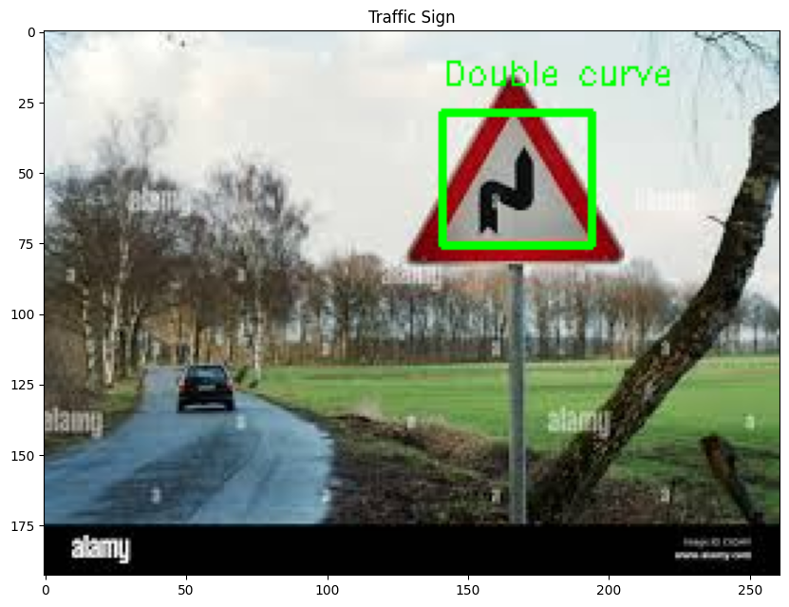
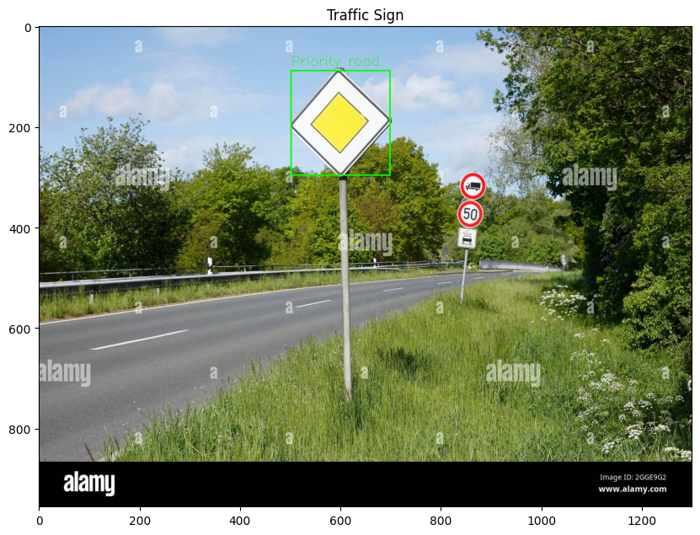
Result 1
Result 2

Slide 13
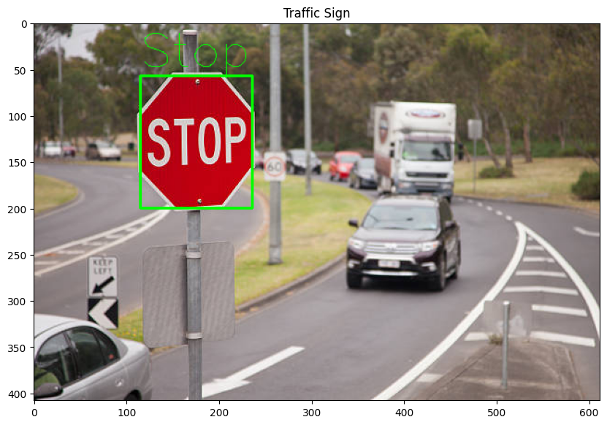
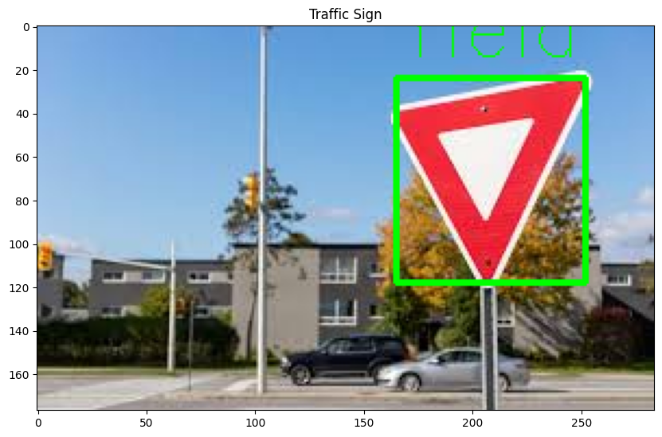
Result 3
Result 4

Slide 14
COMPARISON

Slide 15
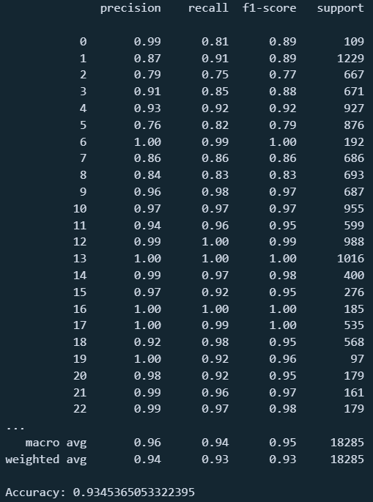
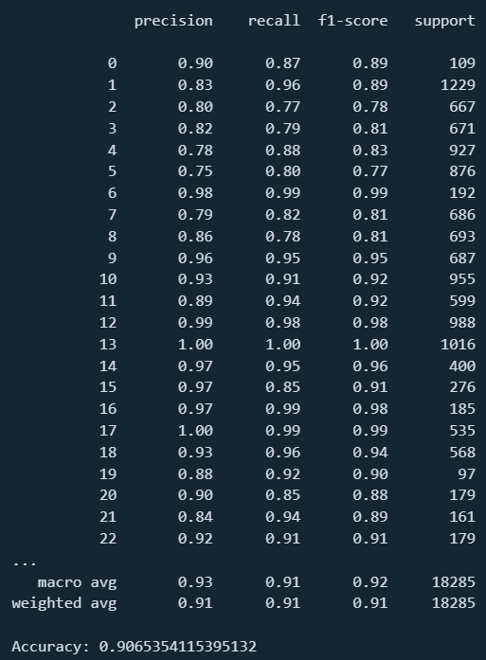


SVM
KNN

Slide 16

QUESION

